Slide 1


SQL FOR DATA ANALYSIS

Slide 2
What is data?
What is a Data?
Any piece of information that is collected and digitally stored.

Slide 3
What is data?
What is a Data?
Any piece of information that is collected and digitally stored.
What are different data formats?

Slide 4
What is data?
What is a Data?
Any piece of information that is collected and digitally stored.
What are different data formats?
Examples: Numbers, text, images, audio, video, etc

Slide 5
What is data?
What is a Data?
Any piece of information that is collected and digitally stored.
What are different data formats?
Examples: Numbers, text, images, audio, video, etc
Where is the data stored?

Slide 6

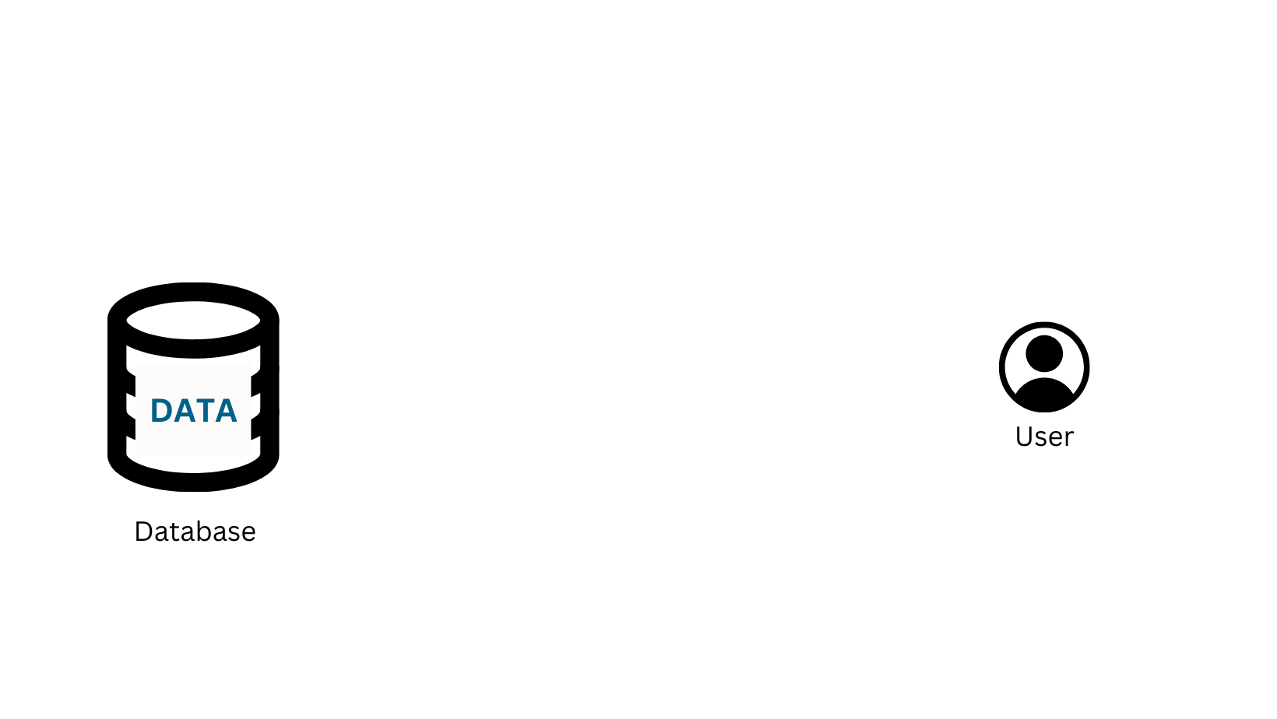


What is data?
What is a Data?
Any piece of information that is collected and digitally stored.
What are different data formats?
Examples: Numbers, text, images, audio, video, etc
Where is the data stored?
Data is digitally stored in Files or Databases.

Slide 7
What is data?
What is a Data?
Any piece of information that is collected and digitally stored.
What are different data formats?
Examples: Numbers, text, images, audio, video, etc
Where is the data stored?
Data is digitally stored in Files or Databases.
Where Are Files & Databases Physically Located?

Slide 8
What is data?
What is a Data?
Any piece of information that is collected and digitally stored.
What are different data formats?
Examples: Numbers, text, images, audio, video, etc
Where is the data stored?
Data is digitally stored in Files or Databases.
Where Are Files & Databases Physically Stored?
Files and databases are physically stored in two main places:
Locally – On your personal computer, hard drive, or company server.
Cloud – On online servers like Google Drive, AWS, or Microsoft Azure.

Slide 9


Slide 10
What is database?
What is a Database?
A database is a organised collection of related data which represents some aspect of the real world.

Slide 11
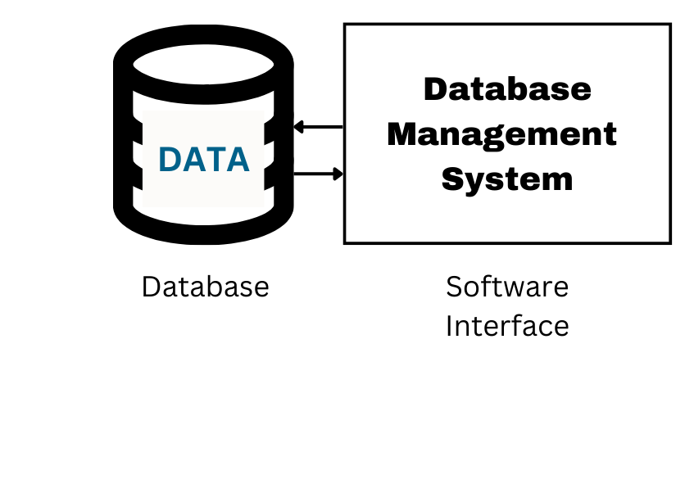
What is database?
What is a Database?
A database is a organised collection of related data which represents some aspect of the real world.
What is a DBMS?
Database Management System.
A Software that manages databases by storing, organizing, securing, and retrieving data efficiently.

Slide 12
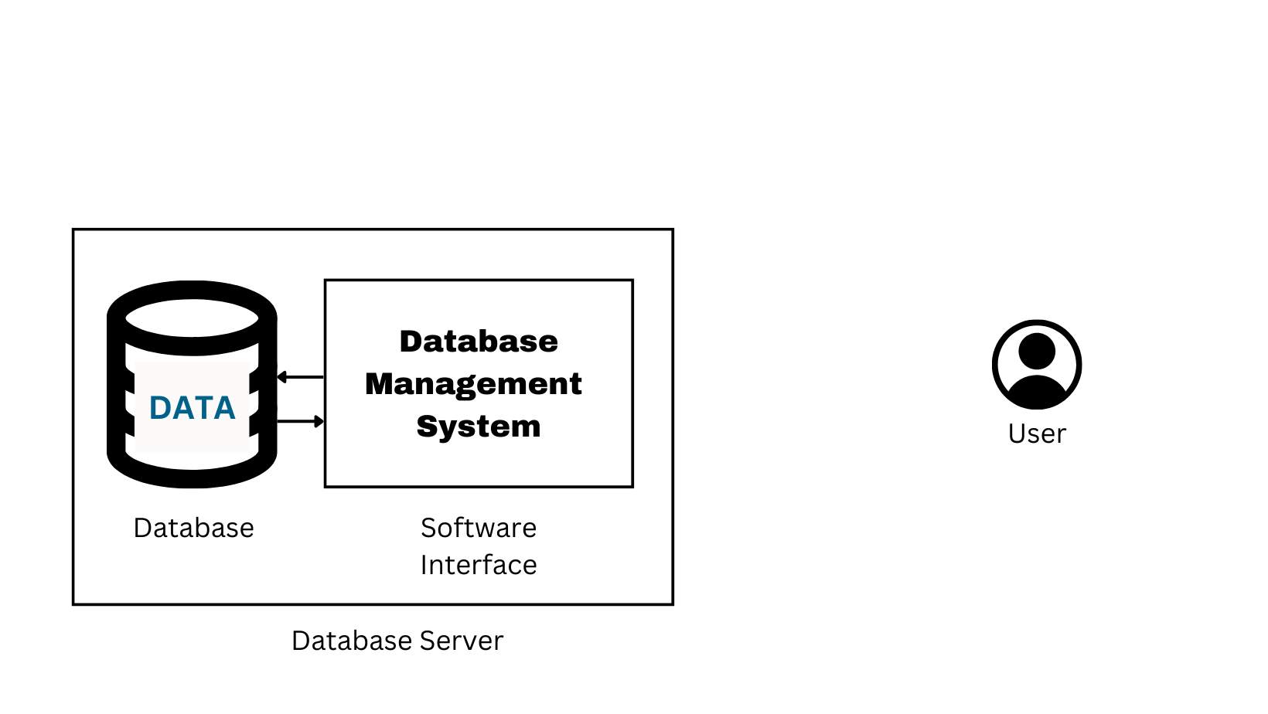
What is database?
What is a Database?
A database is an organised collection of related data which represents some aspect of the real world.
What is a DBMS?
Database Management System.
A Software that manages databases by storing, organizing, securing, and retrieving data efficiently.
What is a Database Server?
Database Server = Database + DBMS

Slide 13
What is database?
Database - stores the actual data
DBMS - manages and processes that data.
Server - provides access to multiple users or applications.

Slide 14
What is database?
Database - stores the actual data
DBMS - manages and processes that data.
Server - provides access to multiple users or applications.

Slide 15
Relational vs non-relational database
Structured vs Unstructured Data
Data in a database can be:
Structured – Organized in tables (rows & columns)
Unstructured – Non-tabular form
Relational vs Non-Relational Databases
Data in a database can be:
Relational Database – Stores Structured Data
Non-Relational Database – Stores Un-Structured Data

Slide 16
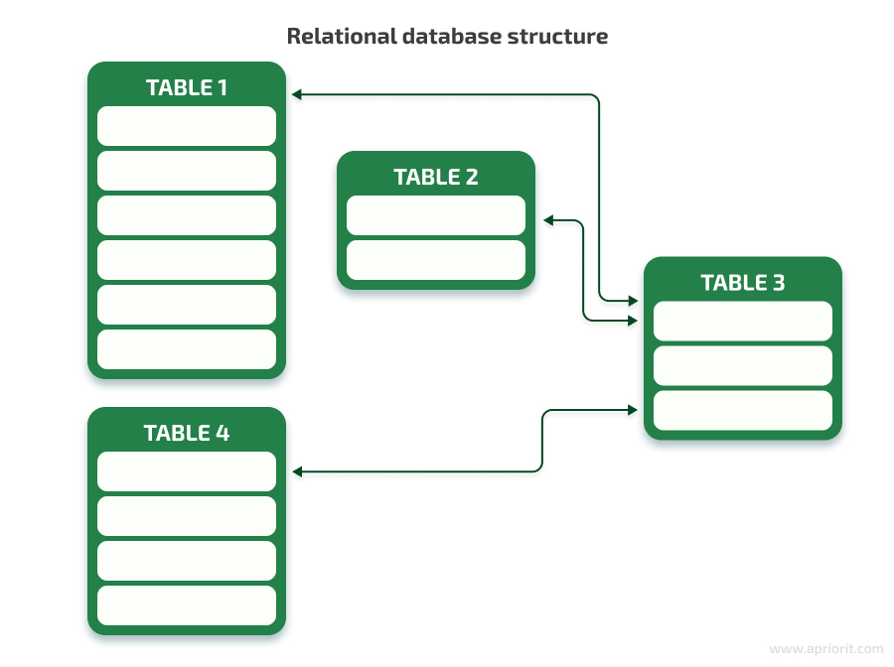
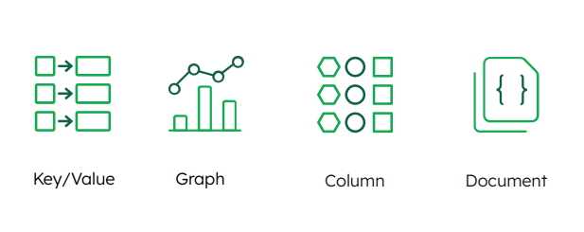
Database Models
Relational
Database
Non-Relational Database

Slide 17
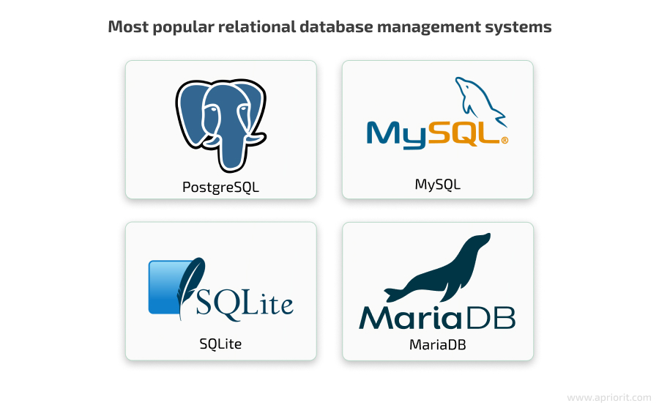
Database Models
Relational
Database
Non-Relational Database

Slide 18
Database Models
Non-Relational Database
Relational
Database
Banking Systems:
Customers ↔ Accounts ↔ Transactions
E-commerce:
Users ↔ Orders ↔ Products ↔ Payments

Slide 19
Database Models
Key-Value Database:
e.g., Redis, DynamoDB
Session Management in E-commerce
Graph Database:
e.g., Neo4j
LinkedIn - "People You May Know" Feature
Column-Family Database:
e.g., Apache Cassandra
Netflix Watch History & Recommendations
Document Database:
e.g., MongoDB, CouchDB
Amazon Product Catalog
Relational
Database
Non-Relational Database

Slide 20
What is MySQL?
What is RDBMS?
Stands for "relational database management system."
An RDBMS is a subset of DBMS designed specifically for relational databases.
Stores data in a structured format, using rows and columns.
It is "relational" because the values within each table are related to each other.
Tables may also be related to other tables.

Slide 21
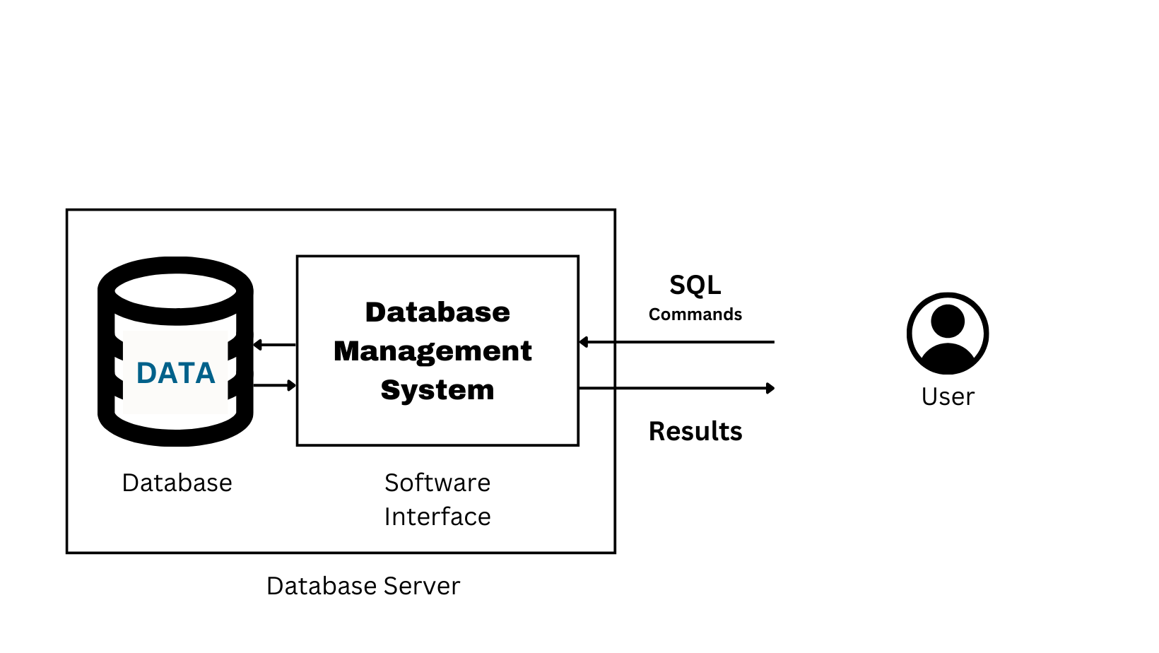
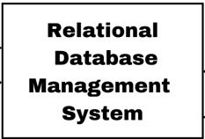
What is SQL?
What is SQL?
SQL stands for “Structured Query Language,” is the programming language that’s been widely used in managing data in relational database management systems (RDBMS).
SQL provides a mechanism for storage, manipulation, retrieval of structured data and security.
SQL has a structure, syntax and order.

Slide 22
How do I pronounce SQL??
Some people pronounce SQL as “sequel” and
others say “ess-cue-ell.”

Slide 23

What is MySQL?
What is MySQL?
MySQL is a relational database management system
MySQL is free and open-source
MySQL was first released in 1995
MySQL is developed, distributed, and supported by Oracle Corporation
MySQL is named after co-founder Monty Widenius's daughter: My

Slide 24
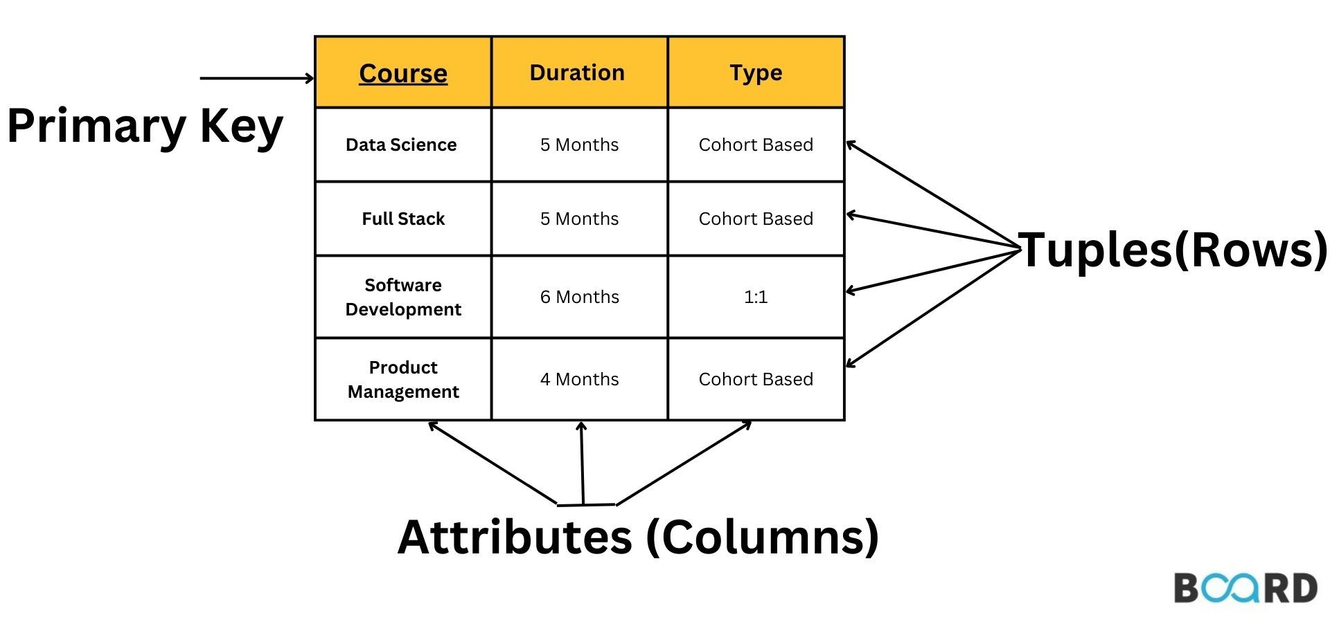
MySQL - Database, Tables, Primary Keys

Slide 25
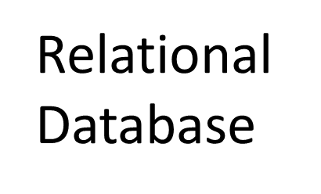
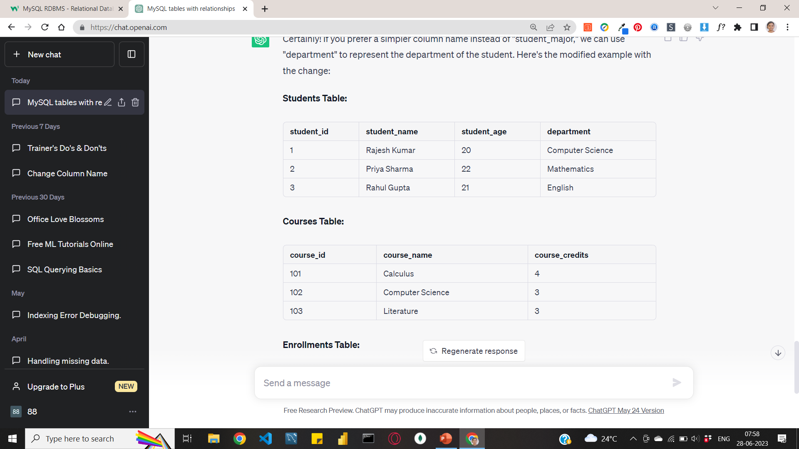
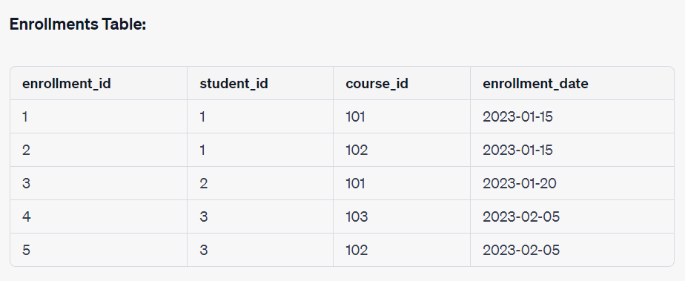
MySQL - Database, Tables, Primary Keys
Related tables

Slide 26
MySQL - Database, Tables, Primary Keys
Data

Slide 27
MySQL - Database, Tables, Primary Keys
numeric
date
Data
text

Slide 28
MySQL - Database, Tables, Primary Keys
Primary Key

Slide 29
MySQL – CRUD Operations
How to access the database?
C - Create
R - Read
U - Update
D - Delete

Slide 30
MySQL – CRUD Operations
How to access the database?
C - Create
R - Read
U - Update
D - Delete

Slide 31
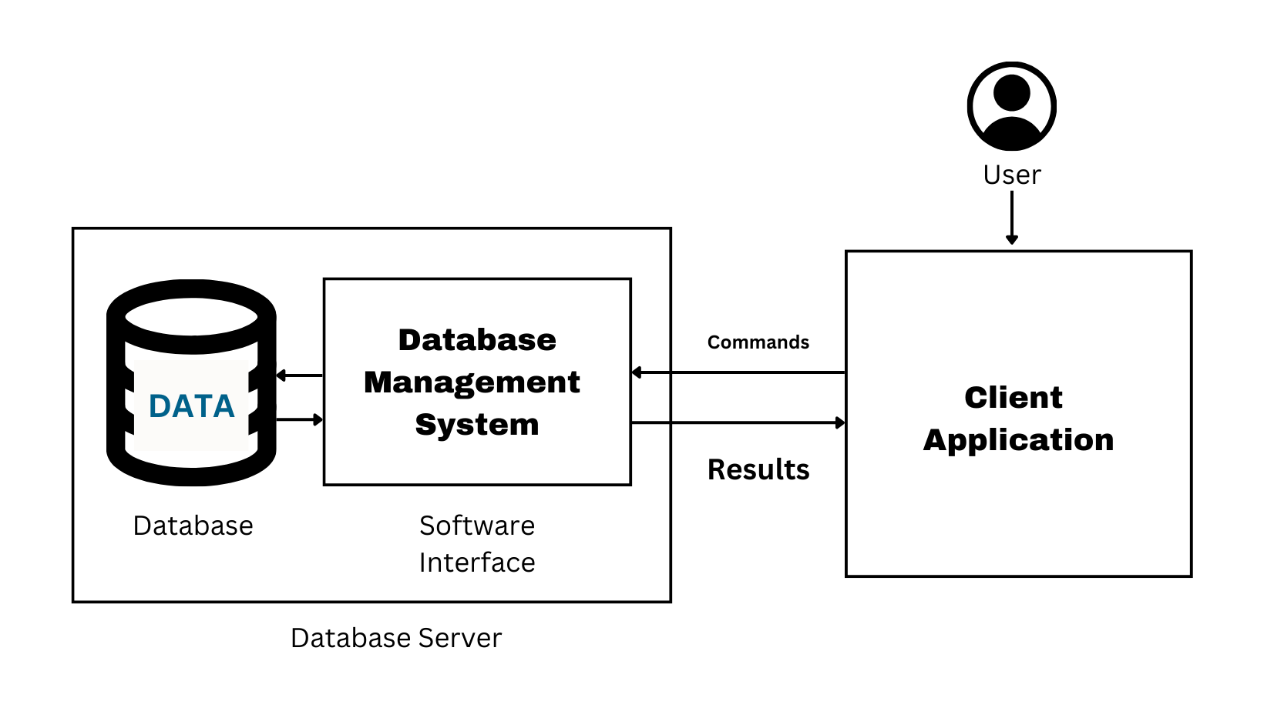
MySQL – Client & Server
How to access the database?
C - Create
R - Read
U - Update
D - Delete

Slide 32
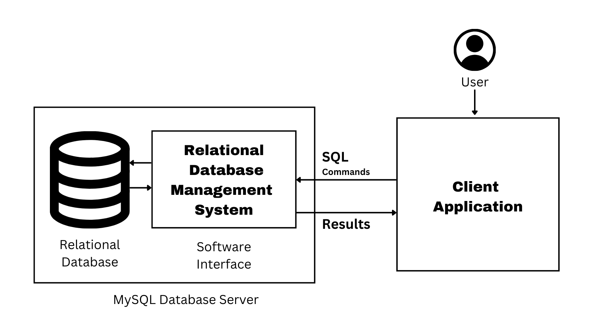
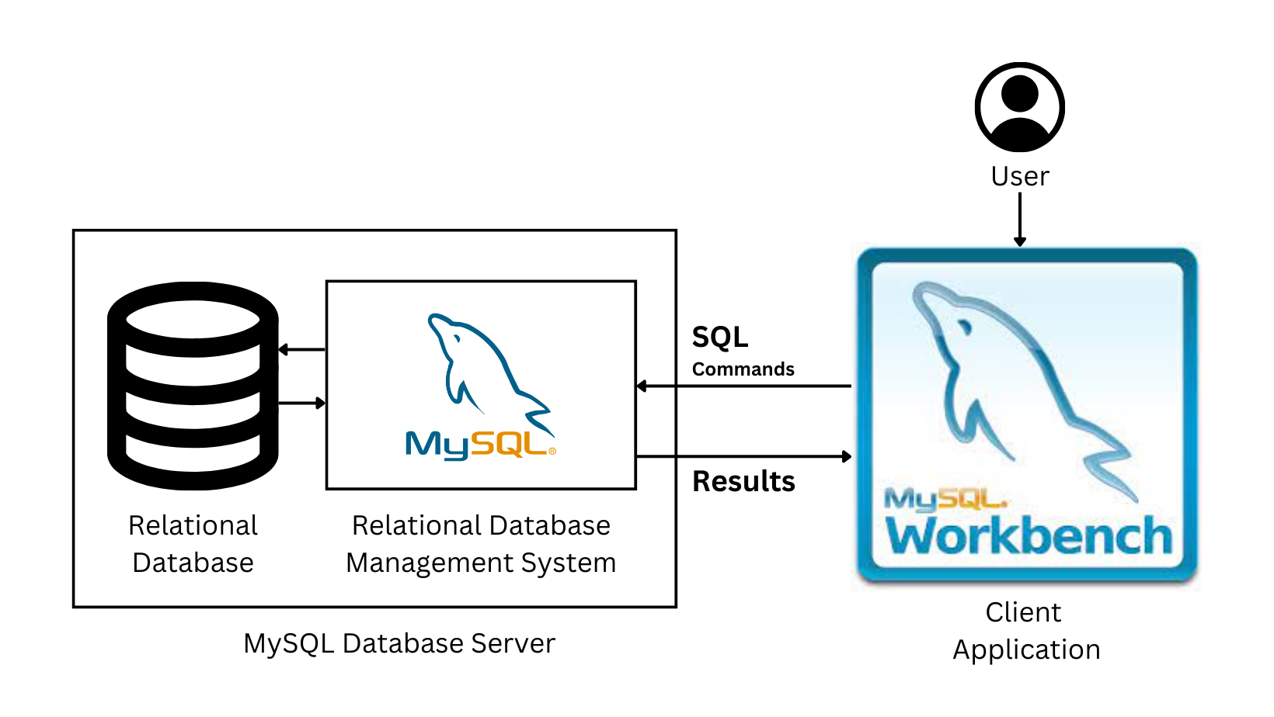
MySQL – Client & Server
MYSQL
.

Slide 33
MySQL – Client & Server
MYSQL
.

Slide 34
MySQL – Client & Server
MYSQL
.

Slide 35
MySQL and Workbench
Installation

Slide 36
RDBMS Popularity

Slide 37
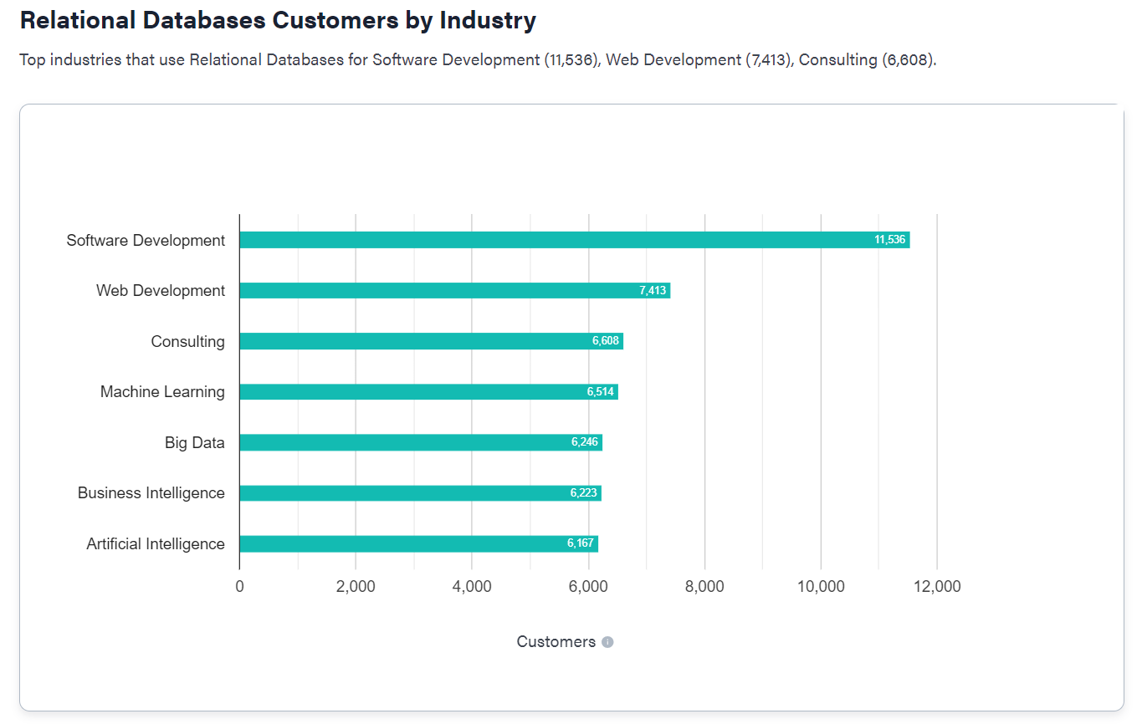

Slide 38
